Slide 1
At Uplands Junior L.E.A.D Academy, we do not tolerate any form of bullying!
Child Friendly
Anti-Bullying Policy
A Community that lives, learns and laughs together.
What is bullying?
Bullying is physical or verbally aggressive behaviour that occurs several times on purpose. It can appear in many forms including;
Emotional - being unfriendly, excluding, tormenting (e.g. hiding books, threatening gestures)
Physical - pushing, kicking, hitting, punching or any use of violence including abuse focused on a particular characteristic (e.g. gender, race, sexuality).
Sexual - unwanted physical contact or sexually abusive comments.
Verbal - name-calling, sarcasm, spreading rumours, teasing.
Cyber – Bullying online (messaging, gaming, videos).
What should you do?
If you are being bullied or see someone being bullied, you must…
Start
Telling
Other
People
Who can you tell?
You could tell:
Mrs Carlisle
Mr Buckley
Mrs Shaukat
Mr Deacon
Mrs Yusuf
Your teacher
Your friend
Peer mentors
Family member/carer
Lunch time assistants
School Council reps
Updated by the School Council September 2024

Slide 2
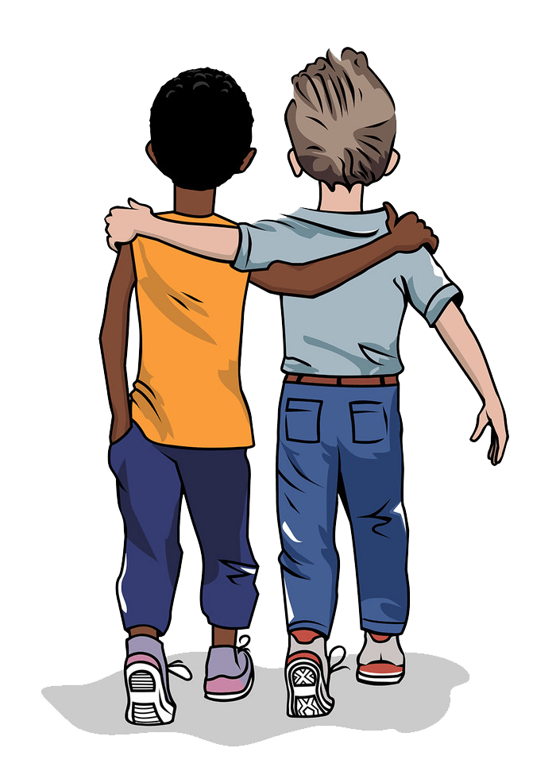
Child Friendly
Behaviour Policy
Our Reward System
We reward children for good behaviour in lots of ways:
Star of the week certificates
Green dots
Book shop
Praise certificates
Recognition in class
Attendance medals
Our behaviour expectations
School Rules:​
Be kind​
Do your best​
Hands and feet to yourself
In school, all children are expected to demonstrate respect, responsibility, and kindness towards others. This includes listening attentively to teachers, following classroom rules, and interacting positively with peers.
By maintaining a positive attitude and resolving conflicts peacefully, students contribute to a supportive and productive learning environment. These behaviours help ensure that everyone can focus on their education and grow in a safe and nurturing space.
Our Consequence System
If the school rules are not followed, there are consequences:
C1: Recorded verbal warning.
C2: 2 minutes outside the class to speak to an adult.
C3 : Miss 10 minutes of playtime.
C4 : Parents are called, lunchtime detention given.
Updated by the School Council September 2024

Slide 3
Child Friendly
Safeguarding Policy
As an academy we have a responsibility to provide a safe environment in which children can learn.
We will make every effort to identify children who may benefit from early help and put in place support as soon as a problem emerges at any point in a child’s life.
We think it is important for our children to know where to get help if they are worried or unhappy about something.
How we protect children at Uplands
At Uplands Junior L.E.A.D Academy, we pride ourselves in the commitment we have to ensuring children are safe at school as well as at home. All children, regardless of age, gender, ability, culture, race, language, religion or sexual identity are treated equally and have equal rights to protection. Every staff member at school has a duty to ensure children are safe.
Speak to our Safeguarding team:
Mrs Carlisle
Mr Buckley
Mr Deacon
Mrs Shaukat
Mr Walker
Mrs Yusuf
Report a concern on the school website at https://www.uplandsacademy.co.uk/
A problem shared, is a problem halved.
Updated by the School Council September 2024

