Slide 1
When are the SATs?
SATs are the Standardised Assessment Tests that are given to children at the end of Key Stage 2.
The SATs take place over four days, starting on Monday 13th May ending on Thursday 16th May.
The SATs papers consist of:
  Spelling, punctuation and grammar (paper 1: Grammar/ Punctuation/ Spelling) – Monday 12th May
  Spelling, punctuation and grammar (paper 2: Spelling test) – Monday 13th May
  Reading – Tuesday 13th May
  Maths (paper 1: Arithmetic) – Wednesday 14th May
  Maths (paper 2: Reasoning) – Wednesday 14th May
  Maths (paper 3: Reasoning) – Thursday 15th May
Notes:
Note that there are no science assessments this academic year (including sampling tests).

Slide 2
Structure of the SATs.
The tests take place during normal school hours, under exam conditions.
Children are not allowed to talk to each other from the moment the assessments are handed out until they are collected at the end of the test.
After the tests are completed, the papers are sent away to be marked externally.
The results are then sent to the school in July.
Each test lasts no longer than 60 minutes:
  Spelling, punctuation and grammar (paper 1: Grammar/ Punctuation) – 45 minutes
  Spelling, punctuation and grammar (paper 2: Spelling) – 15 minutes
  Reading – 60 minutes
  Maths (paper 1: Arithmetic) – 30 minutes
  Maths (paper 2: Reasoning) – 40 minutes
  Maths (paper 3: Reasoning) – 40 minutes

Slide 3
The results
Tests are marked externally. Once marked, the tests will be given the following scores:
A raw score (total number of marks achieved for each paper);
A scaled score (see below);
A judgement on if the National Standard has been met.
After marking each test, the external marker will convert the raw score to a scaled score. Even though the tests are made to the same standard each year, the questions must be different. This means the difficulty of the tests may vary. Scaled scores ensures an accurate comparison of performance over time.
Scaled scores range from 80 to 120.
A scaled score of 100 or more shows the pupil is meeting the National Standard.
A scaled score of 110 or more shows the pupil is meeting the Above National Standard grade. (Greater Depth)
Notes:
There is no separate test that would indicate a pupil is working above the national standard.
A scaled score of less than 99 would indicate a pupil is working below the national standard.
To have a scaled score, pupils must have a minimum raw score (determined each year). If the pupil does not achieve the minimum raw score, they have not demonstrated sufficient understanding of the KS2 curriculum in the subject.

Slide 4
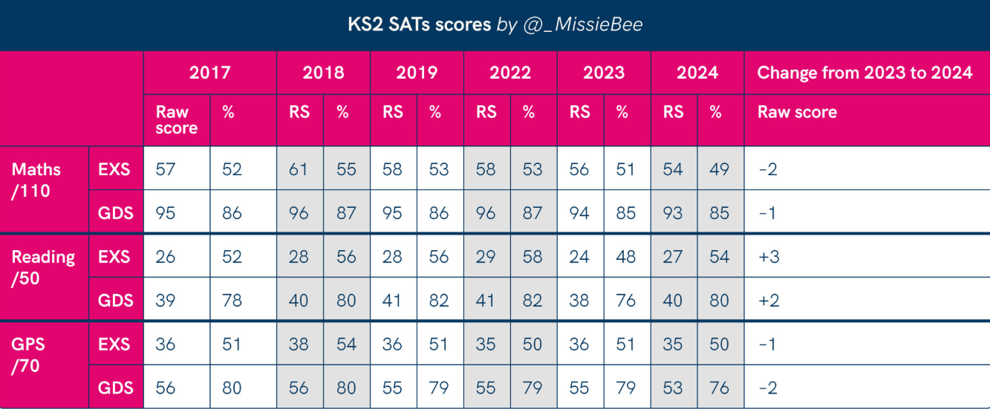

Slide 5
Spelling, Punctuation and Grammar: Monday 12th May
Spelling, Punctuation and Grammar consists of two papers.
Paper 1 focuses on all three elements (spelling, punctuation and grammar). The paper lasts for 45 minutes.
Paper 2 consists of a spelling test only. It should take approximately 15 minutes, although this is not a set amount of time.

Slide 6
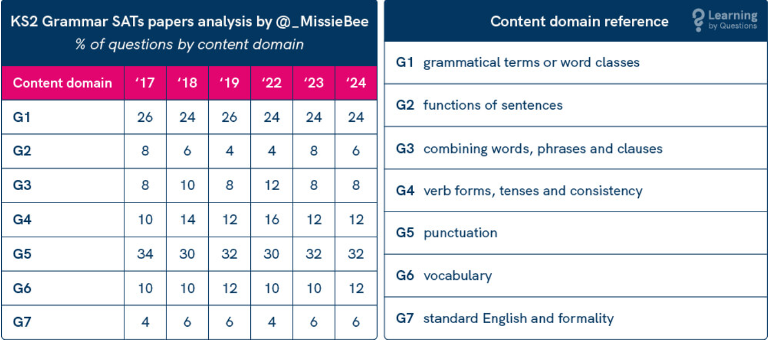

Slide 7
Reading: Tuesday 13th May
There is one reading test that lasts for 60 minutes.
The test is designed to measure if the children’s comprehension of age-appropriate reading material meets the national standard. There are three different set texts for children to read. These could be any combination of non-fiction, fiction and/ or poetry.
Stamina is vital and needing to read quickly around 130-150 words per minute with understanding is the target for all children. If they can then they will get through the texts in the time given.

Slide 8
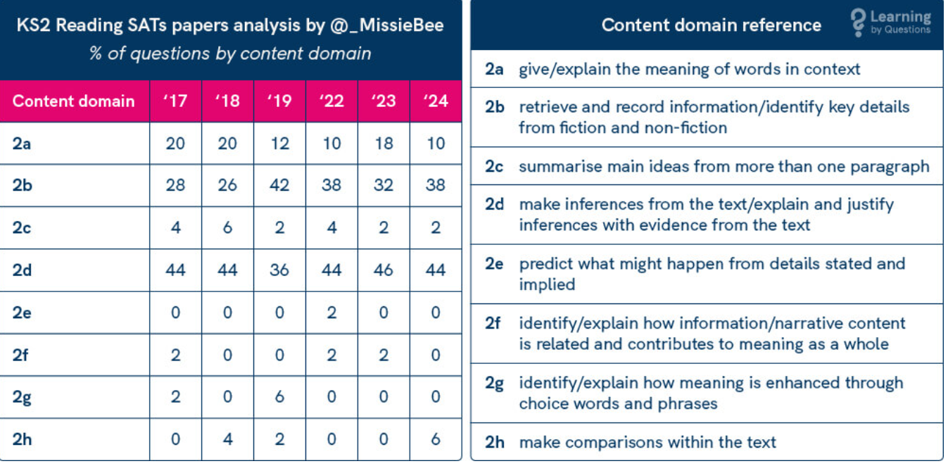

Slide 9
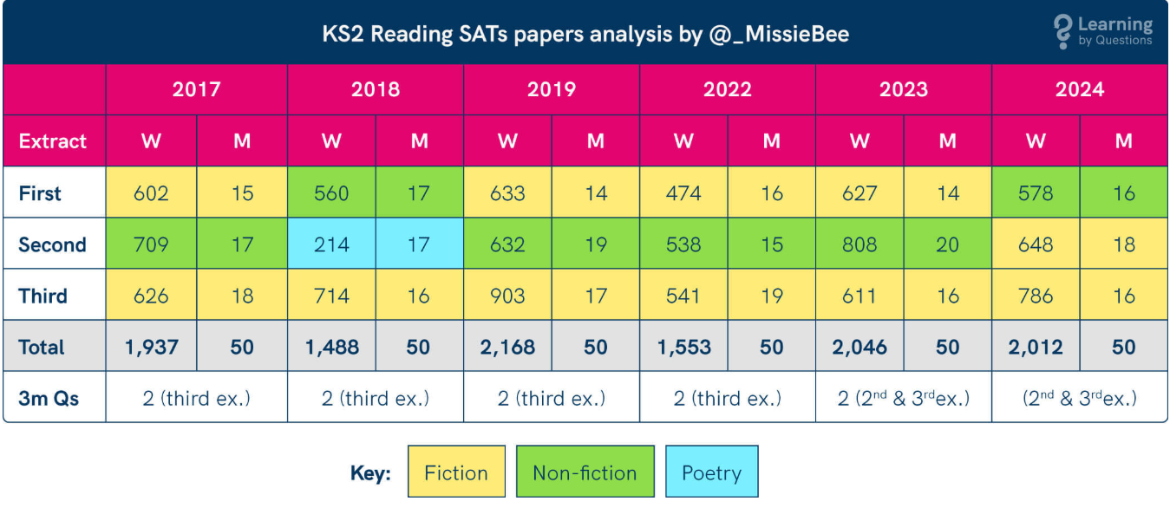
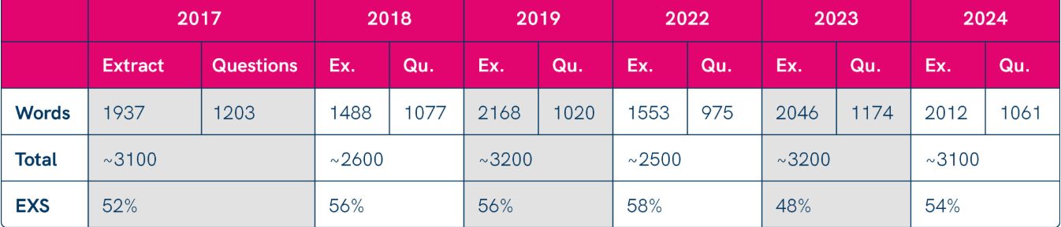

Slide 10
Maths: Wednesday 14th May and Thursday 15th May
The maths assessments consist of three tests.
Paper 1: Arithmetic (30 minutes) – Wednesday 14 ^{th} May
Paper 2: Reasoning (40 minutes) – Wednesday 14 th May
Paper 3: Reasoning (40 minutes) – Thursday 15 ^{th} May

Slide 11
Maths Papers 2 and 3 (Reasoning)
Paper 2 will take place on Wednesday 14th May and paper 3 will take place on Thursday 15th May. These tests have a total of 35 marks each.
These papers require children to demonstrate their mathematical knowledge and skills, as well as their ability to solve problems and their mathematical reasoning. They cover a wide range of mathematical topics from key stage 2 including,
Number and place value (including Roman numerals);
The four operations;
Geometry (properties of shape, position and direction);
Statistics;
Measurement (length, perimeter, mass, volume, time, money);
Algebra;
Ratio and proportion;
Fractions, decimals and percentages.
Notes:
In general, the questions get progressively harder throughout the paper. As this is the case, it is not unusual for children to be unable to complete the entire paper in the given time. Maths Paper 1 (Arithmetic)

Slide 12
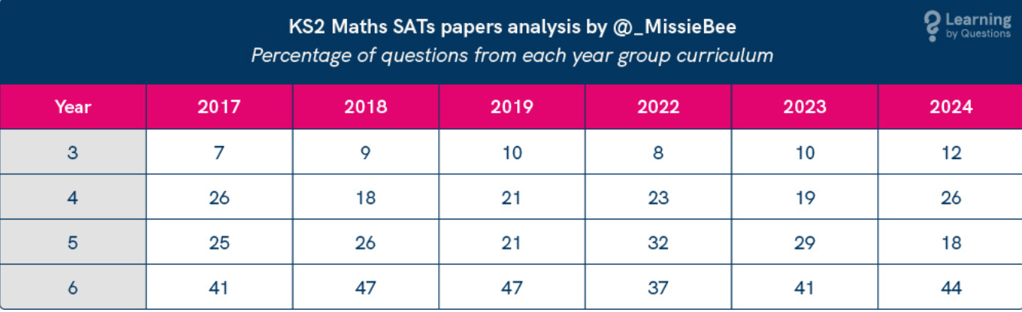

Slide 13
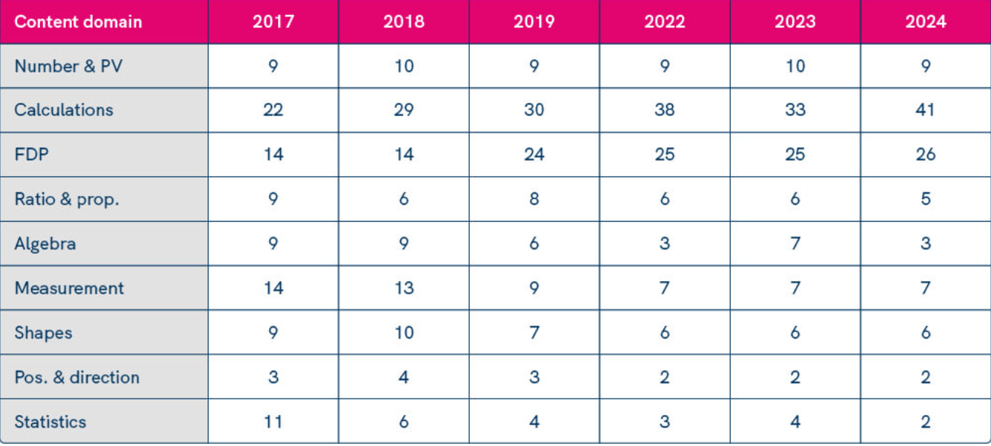

Slide 14
Supporting your child in preparing for the SATs
Tips:
Look back through their past papers that were sent home by the school to go over and prepare the children.
Use a timetable from now until SATs on things they should be doing every night. Little and often. Spellings. TTRs. Reading. Use of Sats Bootcamp and the revision guides (Pearsons Books)
Give your child time to go outside and reduce screen time.
Ensure your child is eating and drinking well and getting a good amount of sleep.
Make sure your child is in school for 8:00am everyday in sats week.
Notes:
Encourage parents not to use past papers at home. If they want to use past papers with tutors, suggest that they could take copies of completed test home to work through with tutors. This may help them to work through specific misunderstandings.

Slide 15
Supporting your child in preparing for the SATs
Tips:
Ensure your child has the best possible attendance at school.
DO Not take term time holidays as they will miss vital learning.
Support your child with any homework tasks. Make good use of the revision guides!
Reading, spelling and arithmetic (e.g. times tables) are always good to practice.
Talk to your child about what they have learnt at school and what book(s) they are reading (the character, the plot, their opinion).
Make sure your child has a good sleep and healthy breakfast every morning!
Notes:
Encourage parents not to use past papers at home. If they want to use past papers with tutors, suggest that they could take copies of completed test home to work through with tutors. This may help them to work through specific misunderstandings.

Slide 16
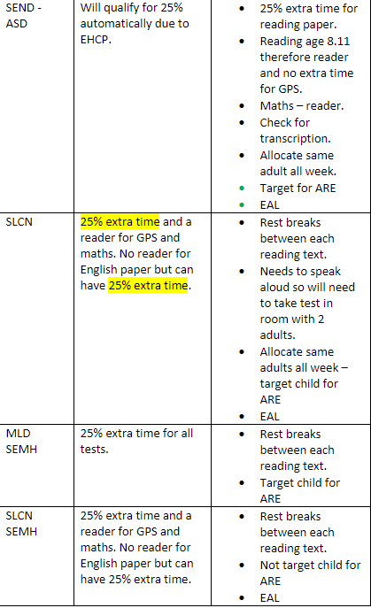
Access Arrangements:
Without going into detail of who they are, some children will have access to adult support. This comes in the form of a reader and your child will already know if they have extra support.
Make sure you speak to your children about putting their hand up to have questions read if they are unsure and to use their time wisely.
Many adults are needed, and children have been split for the test, so they must be on time and ready to go.
Some will be with Mrs. Woods in the hall whilst others test but this is so we can support all the children who need it.

Slide 17
What if my child is ill?
We need them in school. If they miss a test, there is nothing we can do.
Bring them in and as soon as they have finished, we will send them home if we feel they are too poorly to stay.
Make sure that they eat a healthy and home cooked meal from Sunday so as to reduce the risk of food poisoning during the week. Lots of natural vitamins and healthy food choices will support them.
Earlier nights are important as they allow the children to focus during the test and we need them to be ready to start.
When should my child be in?
We are starting the first test at 9:00 prompt. Children will need to be read the instructions, will need to fill out the front of the form and be reminded of the rules.
We will also do a warm up and reminder before the test starts. Therefore children will be in class from 08:30 and no later.
Breakfast club is open and free to all students and we strongly recommend you drop them off at 8:00am every morning.

Slide 18
Other points to remember
Writing is assessed using evidence collected throughout Year 6. There are no Year 6 SATs writing tests. Writing continues to be taught right up until the end of June after SATs so don’t take your child out of school.
Writing assessments will be formed from judgements made by the teacher, looking at evidence from writing collected over the course of the year.
The teacher will moderate their assessments with other professionals to make sure there is a consistent standard across the country.
Final judgements will be reported to parents at the same time as the other assessment results.

